Slide 1
Convolutional Networks
Lecture slides for Chapter 9 of Deep Learning
Ian Goodfellow
2016-09-12
Adapted by m.n. for CMPS 392

Slide 2
Convolutional networks
Specialized kind of neural network for processing data that has a known, grid-like topology.
Examples include
time-series data, which can be thought of as a 1D grid taking samples at regular time intervals,
and image data, which can be thought of as a 2D grid of pixels.
Convolutional networks are simply neural networks that use convolution in place of general matrix multiplication in at least one of their layers.

Slide 3
Key Idea
Replace matrix multiplication in neural nets with convolution
Everything else stays the same
Maximum likelihood
Back-propagation
etc.

Slide 4
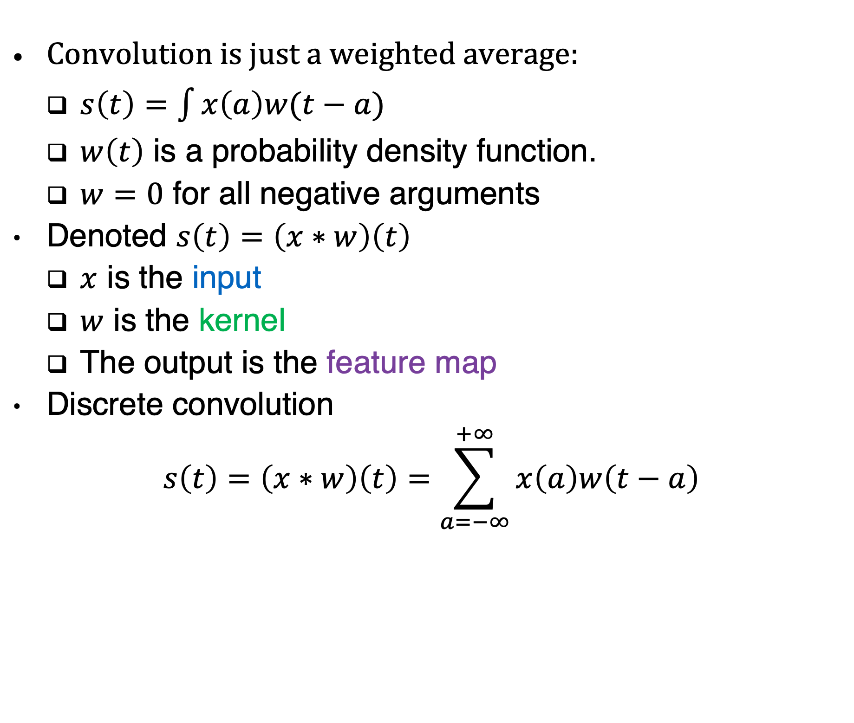
Convolution
Convolution is just a weighted average:
$s\left(t\right)=\int{x\left(a\right)w(t−a)}$
$w\left(t\right)$ is a probability density function.
$w=0$ for all negative arguments
Denoted $s\left(t\right)=\left(x∗w\right)\left(t\right)$
$x$ is the input
$w$ is the kernel
The output is the feature map
Discrete convolution
$$s\left(t\right)=\left(x∗w\right)\left(t\right)=\sum_{a=−∞}^{+∞}{x\left(a\right)w\left(t−a\right)}$$

Slide 5
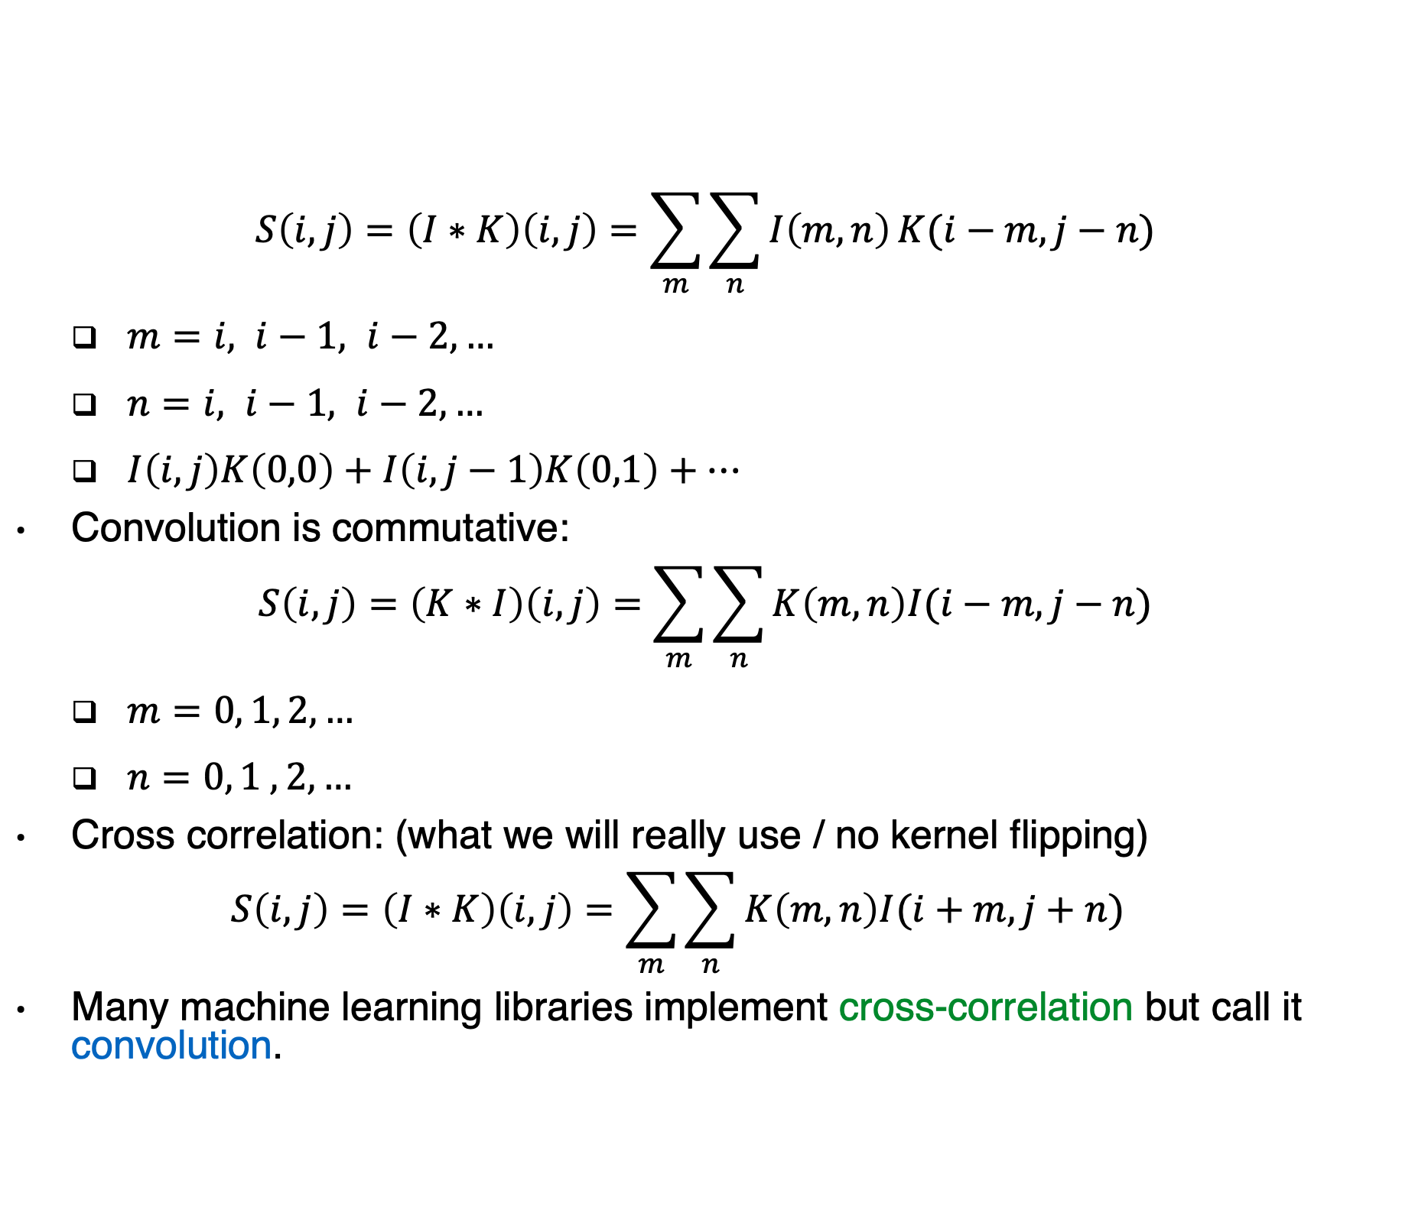
2D convolution
$$S\left(i,j\right)=\left(I∗K\right)\left(i,j\right)=\sum_{m}{\sum_{n}{I\left(m,n\right)}K(i−m,j−n)}$$
$m=i, i−1, i−2, …$
$n=i, i−1, i−2, …$
$I\left(i,j\right)K\left(0,0\right)+I\left(i,j−1\right)K\left(0,1\right)+…$
Convolution is commutative:
$$S\left(i,j\right)=\left(K∗I\right)\left(i,j\right)=\sum_{m}{\sum_{n}{K\left(m,n\right)I(i−m,j−n)}}$$
$m=0, 1, 2,…$
$n=0, 1 , 2,…$
Cross correlation: (what we will really use / no kernel flipping)
$$S\left(i,j\right)=\left(I∗K\right)\left(i,j\right)=\sum_{m}{\sum_{n}{K\left(m,n\right)I(i+m,j+n)}}$$
Many machine learning libraries implement cross-correlation but call it convolution.

Slide 6
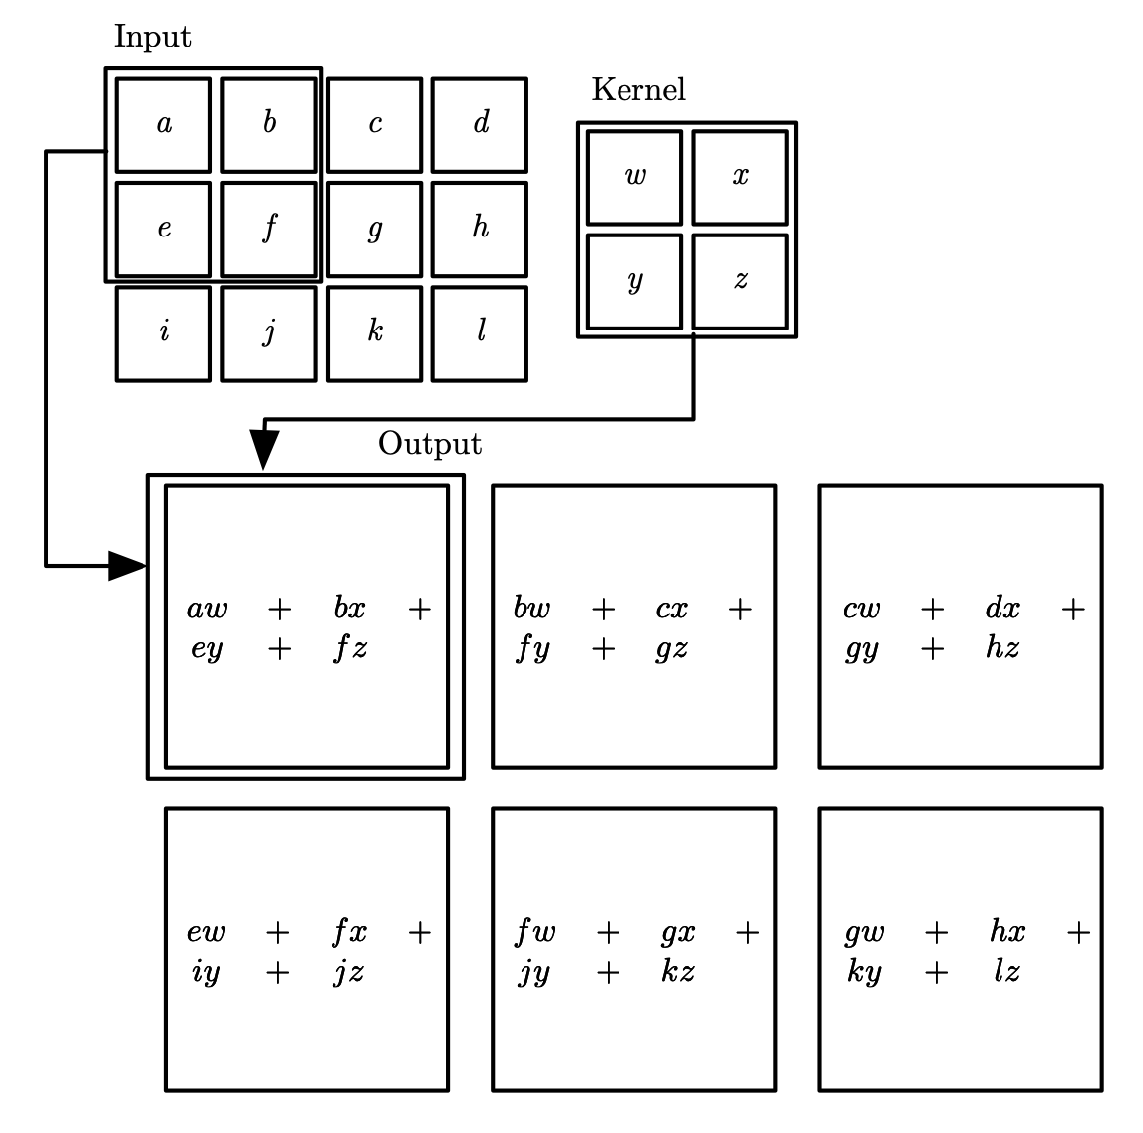
2D ”valid” Convolution
Figure 9.1

Slide 7
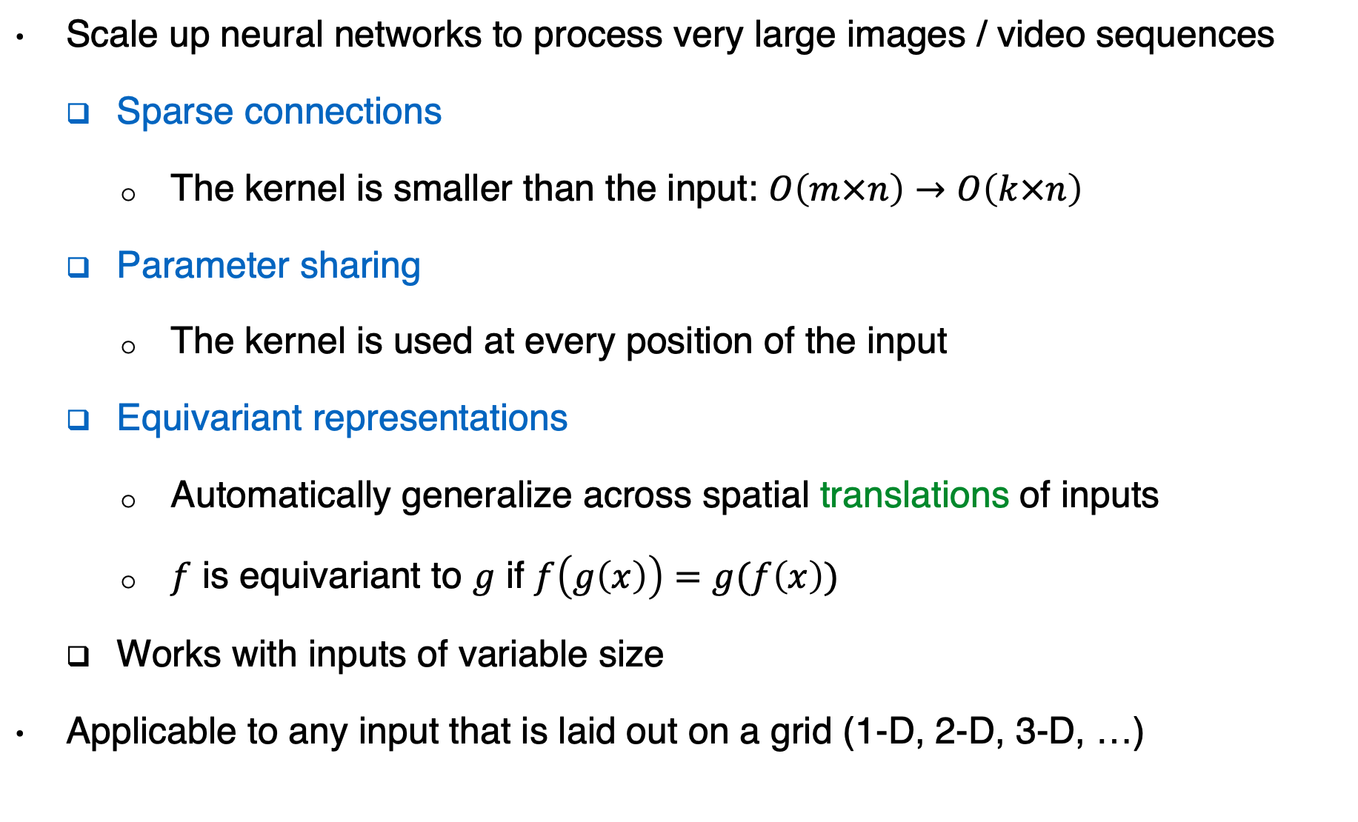
Motivation
Scale up neural networks to process very large images / video sequences
Sparse connections
The kernel is smaller than the input: $O\left(m×n\right)→O\left(k×n\right)$
Parameter sharing
The kernel is used at every position of the input
Equivariant representations
Automatically generalize across spatial translations of inputs
$f$ is equivariant to $g$ if $f\left(g\left(x\right)\right)=g(f\left(x\right))$
Works with inputs of variable size
Applicable to any input that is laid out on a grid (1-D, 2-D, 3-D, …)

Slide 8
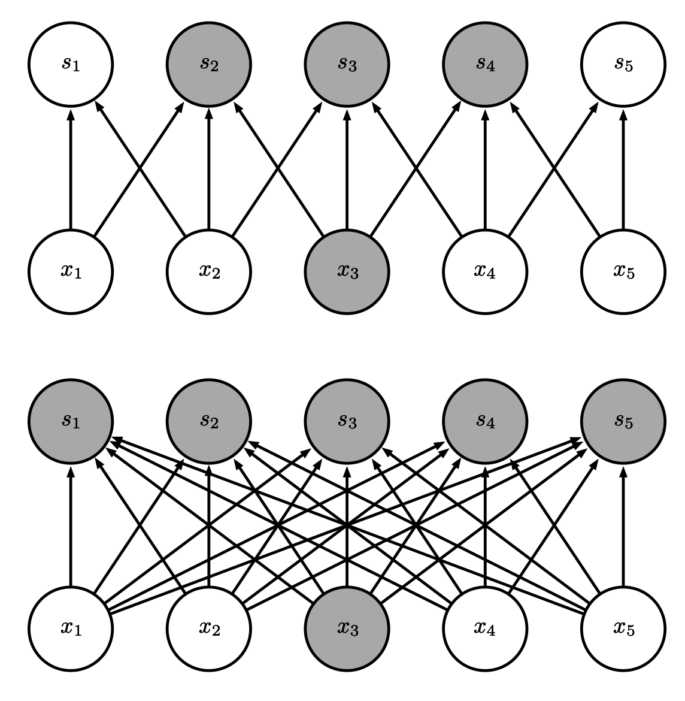
Sparse Connectivity (viewed from below)
Sparse
connections
due to small
convolution
kernel
Dense
connections
Figure 9.2

Slide 9
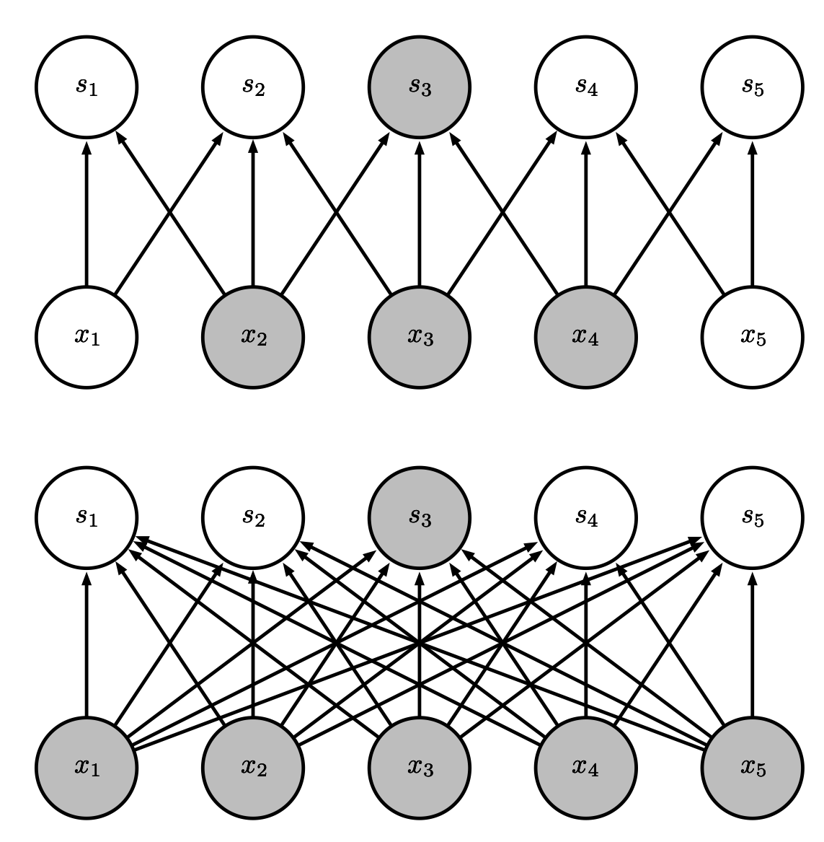
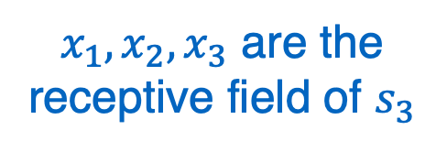
Sparse Connectivity (viewed from above)
Sparse
connections
due to small
convolution
kernel
$x_{1}, x_{2},x_{3}$ are the receptive field of $s_{3}$
Dense
connections
Figure 9.3

Slide 10
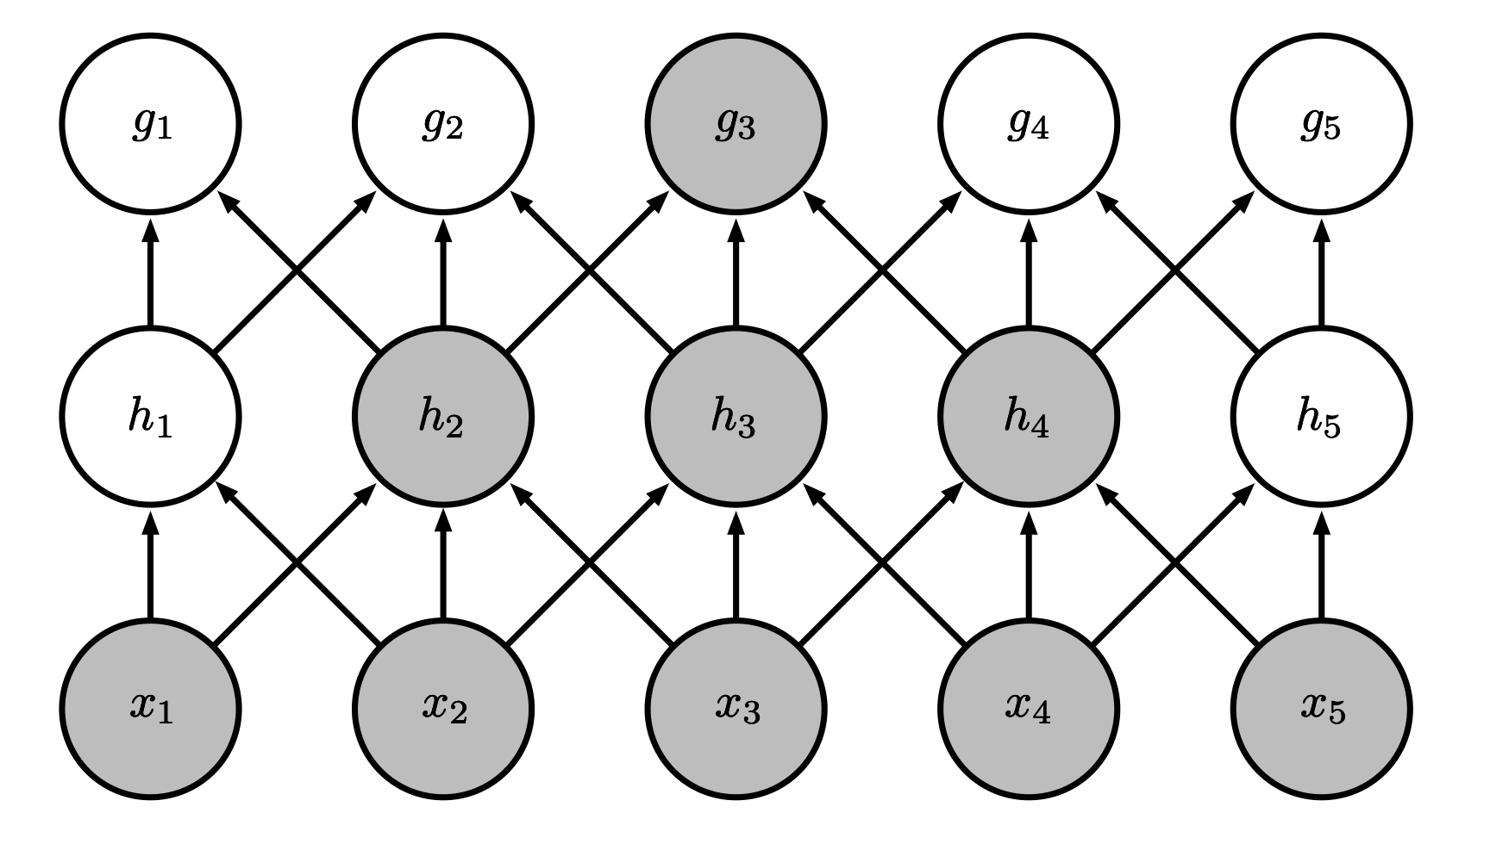
Growing Receptive Fields
Even though direct connections in a convolutional net are very sparse, units in the deeper layers can be indirectly connected to all or most of the xinput image.
Figure 9.4

Slide 11
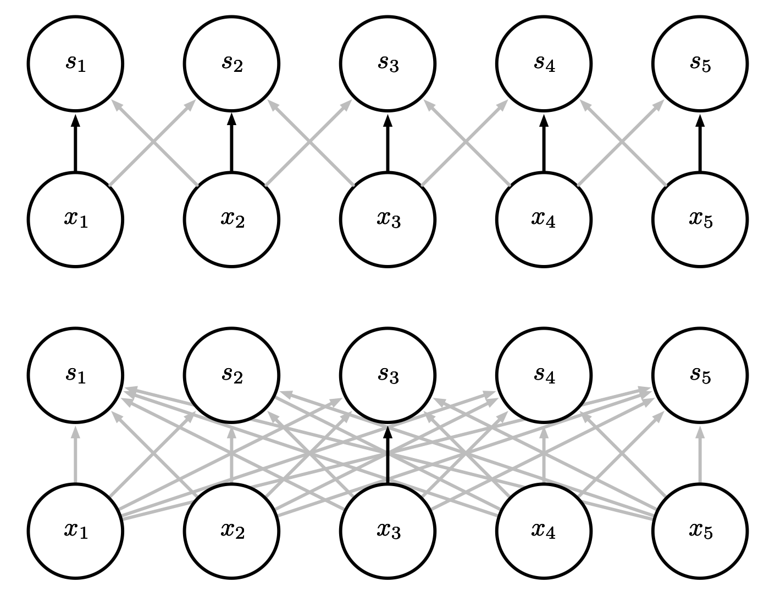
Parameter Sharing
Convolution shares the same parameters across all spatial locations
Traditional matrix multiplication does not share any parameters
Figure 9.5

Slide 12
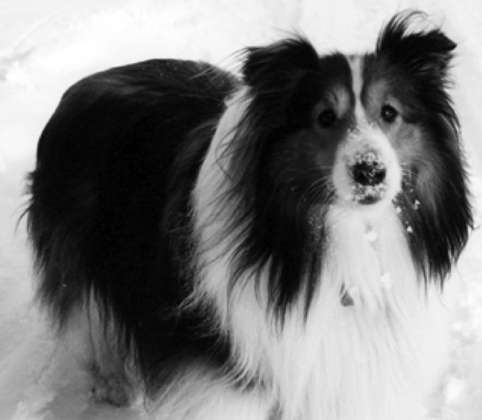
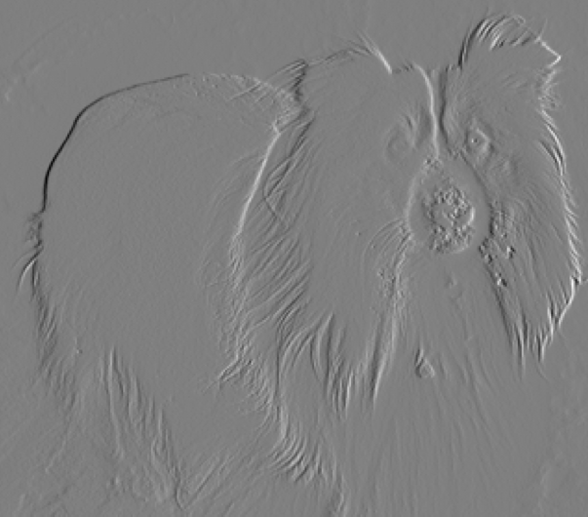
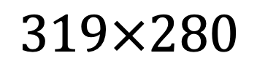
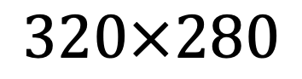
Edge Detection by Convolution
$$320×280$$
$$319×280$$
Input
-1 | -1
Output
Kernel
Figure 9.6

Slide 13
Efficiency of Convolution
Input size: 320 by 280
Kernel size: 2 by 1
Output size: 319 by 280
 | Convolution | Dense matrix | Sparse matrix
Stored floats | 2 | 319*280*320*280 > 8e9 | 2*319*280 = 178,640
Float muls or adds | 319*280*3 = 267,960 | > 16e9 | Same as convolution (267,960)

Slide 14
Pooling
A typical layer of a convolutional network consists of three stages
In the first stage, the layer performs several convolutions in parallel to produce a set of linear activations.
In the second stage, each linear activation is run through a nonlinear activation function, such as the rectified linear activation function. This stage is sometimes called the detector stage.
In the third stage, we use a pooling function to modify the output of the layer further.
A pooling function replaces the output of the net at a certain location with a summary statistic of the nearby outputs:
The max pooling operation reports the maximum output within a rectangular neighborhood
Average pooling, weighted average pooling, L2 norm, etc.

Slide 15
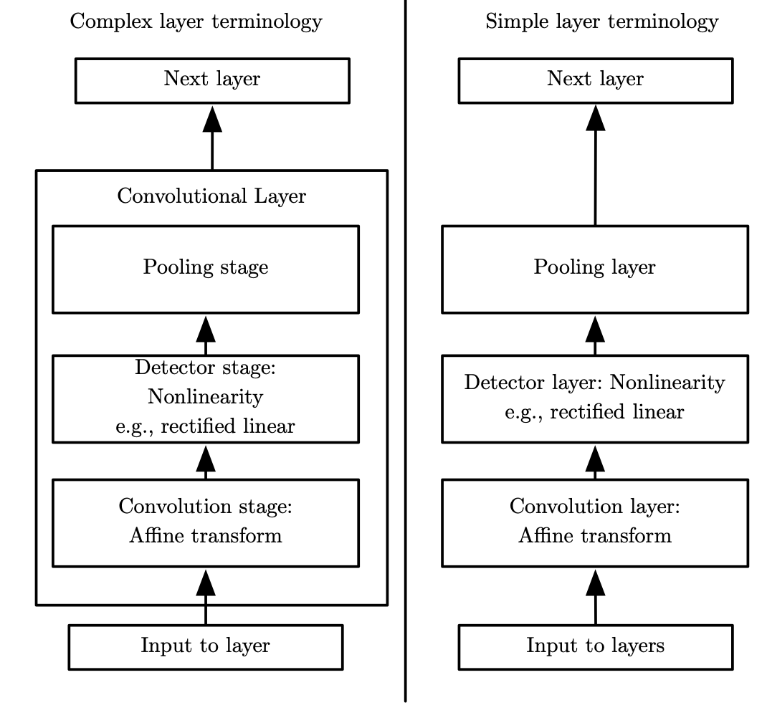
Convolutional Network Components
Figure 9.7

Slide 16
Why pooling?
Invariance:
Pooling helps to make the representation become approximately invariant to small translations of the input.
Invariance to translation means that if we translate the input by a small amount, the values of most of the pooled outputs do not change.
Invariance to local translation can be a very useful property if we care more about whether some feature is present than exactly where it is.
The use of pooling can be viewed as adding an infinitely strong prior that the function the layer learns must be invariant to small translations.
Efficiency:
Pooling units summarize detector units by reporting summary statistics for pooling regions spaced k pixels apart rather than 1 pixel apart.
This improves the computational efficiency of the network
improved statistical efficiency and reduced memory requirements for storing the parameters.

Slide 17
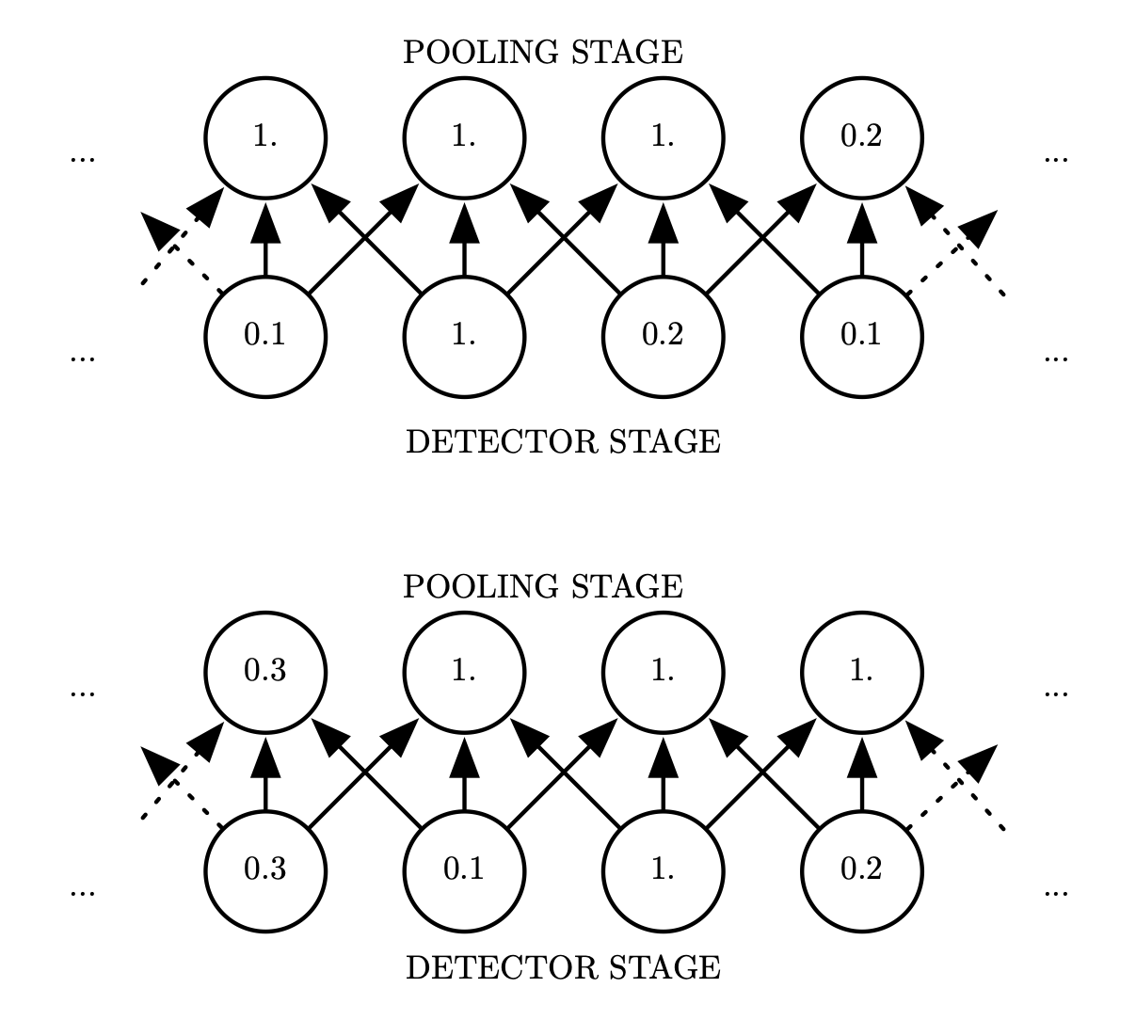
Max Pooling and Invariance to Translation
Stride = 1
Width = 3
Figure 9.8

Slide 18
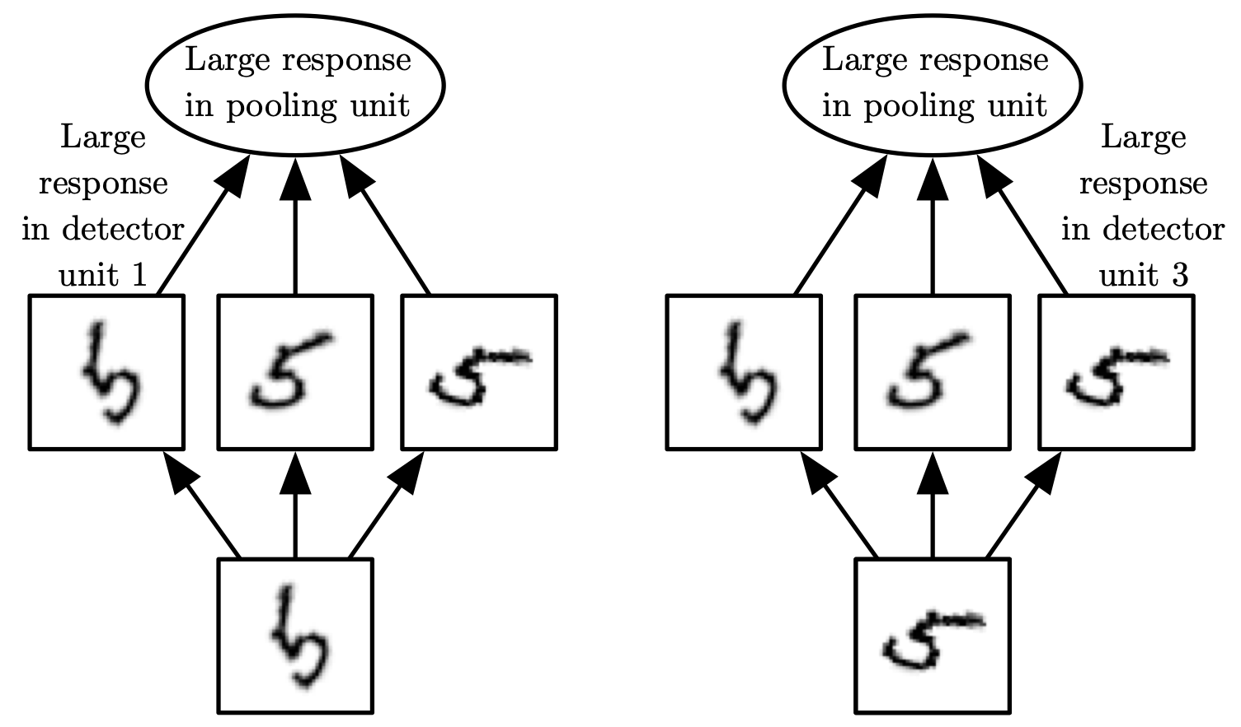
Cross-Channel Pooling and Invariance to Learned Transformations
Figure 9.9

Slide 19
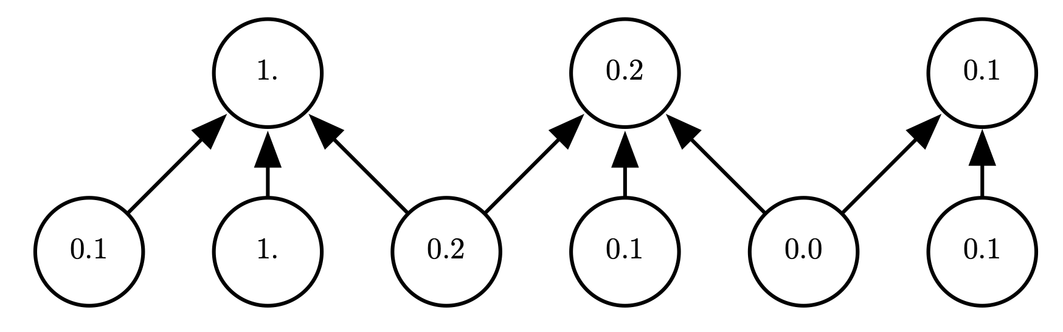
Pooling with Downsampling
Stride = 2
Width = 3
Figure 9.10

Slide 20
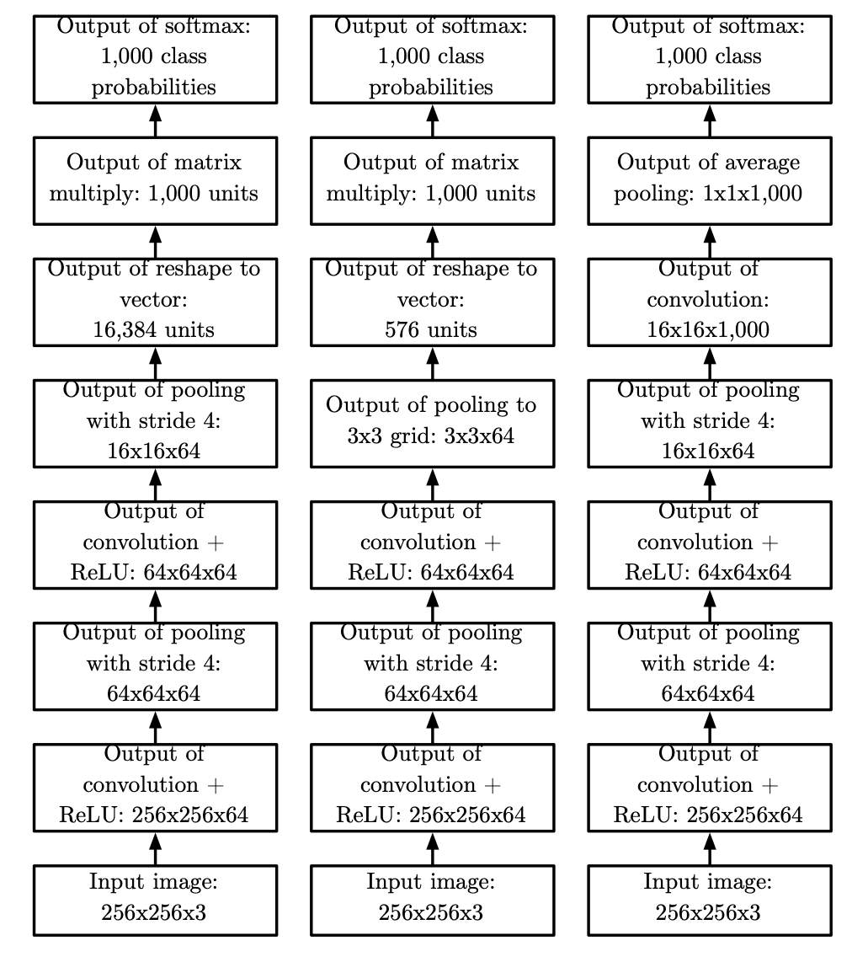
Example Classification Architectures
The specific strides and depths used in this figure are not advisable for real use
Figure 9.11

Slide 21
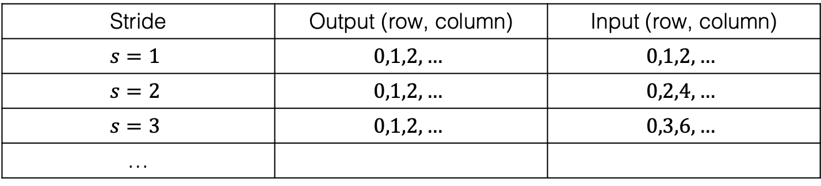
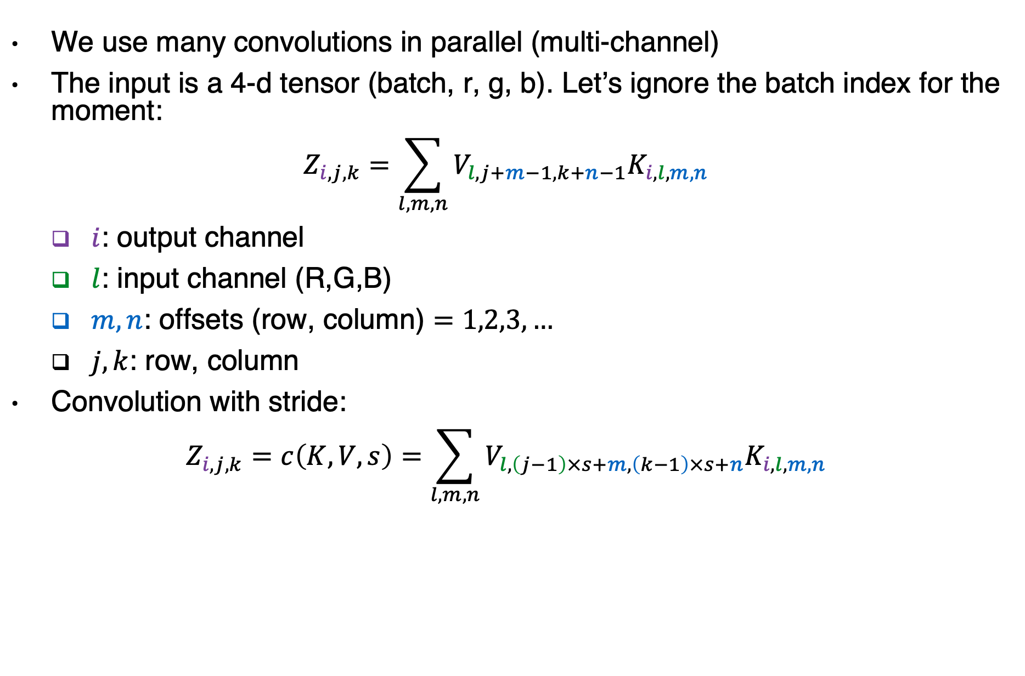
Variants of the convolution function
We use many convolutions in parallel (multi-channel)
The input is a 4-d tensor (batch, r, g, b). Let’s ignore the batch index for the moment:
$$Z_{i,j,k}=\sum_{l,m,n}{V_{l,j+m−1,k+n−1}K_{i,l,m,n}}$$
$i$: output channel
$l$: input channel (R,G,B)
$m,n$: offsets (row, column) $=1,2,3,…$
$j,k$: row, column
Convolution with stride:
$$Z_{i,j,k}=c\left(K,V,s\right)=\sum_{l,m,n}{V_{l,\left(j−1\right)×s+m,\left(k−1\right)×s+n}K_{i,l,m,n}}$$
Stride | Output (row, column) | Input (row, column)
$$s=1$$ | $$0,1,2, …$$ | $$0,1,2, …$$
$$s=2$$ | $$0,1,2, …$$ | $$0,2,4, …$$
$$s=3$$ | $$0,1,2, …$$ | $$0,3,6, …$$
…

Slide 22
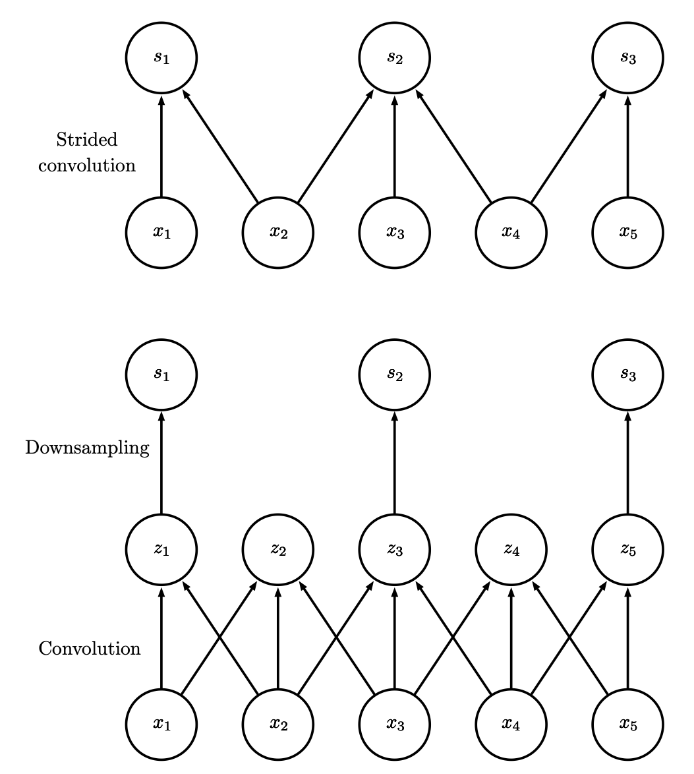
Convolution with Stride
Stride of 2
Figure 9.12

Slide 23
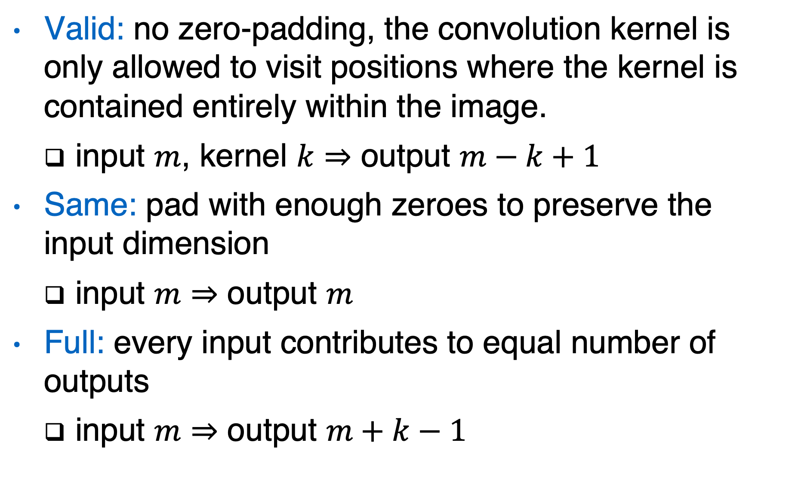
Zero padding
Valid: no zero-padding, the convolution kernel is only allowed to visit positions where the kernel is contained entirely within the image.
input $m$, kernel $k⇒$ output $m−k+1$
Same: pad with enough zeroes to preserve the input dimension
input $m$ $⇒$ output $m$
Full: every input contributes to equal number of outputs
input $m$ $⇒$ output $m+k−1$
Notes:
Usually valid and same are better than full

Slide 24
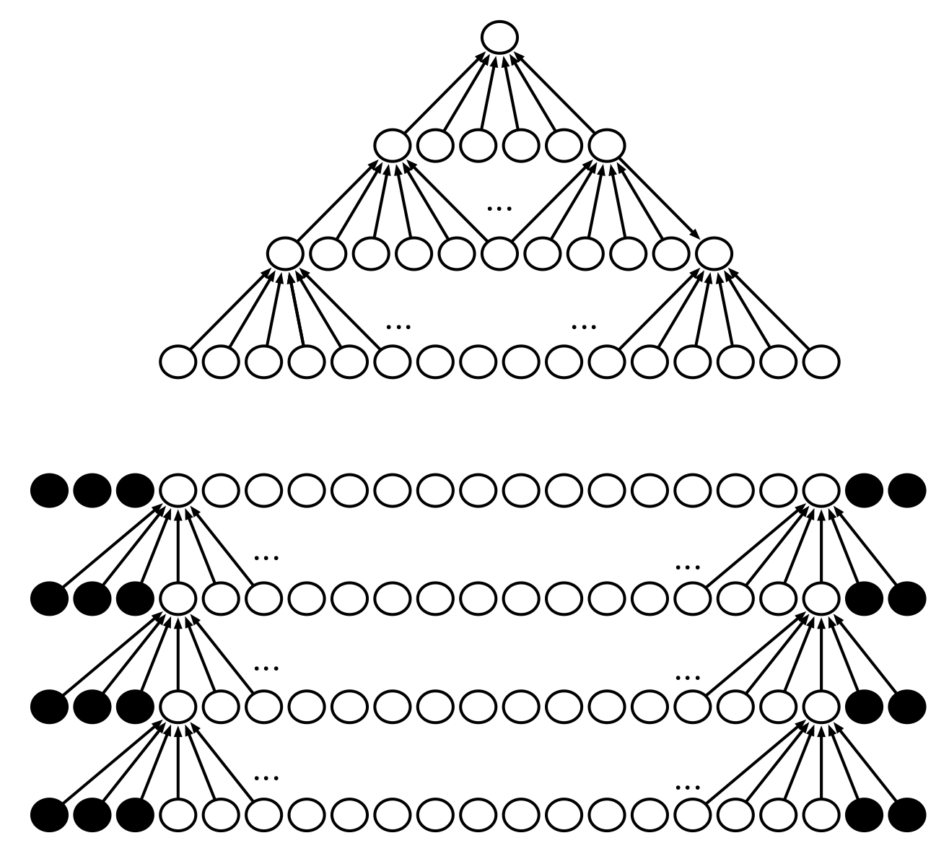
Zero Padding Controls Size
Without zero
Padding (valid)
With zero
Padding (same)
Figure 9.13

Slide 25
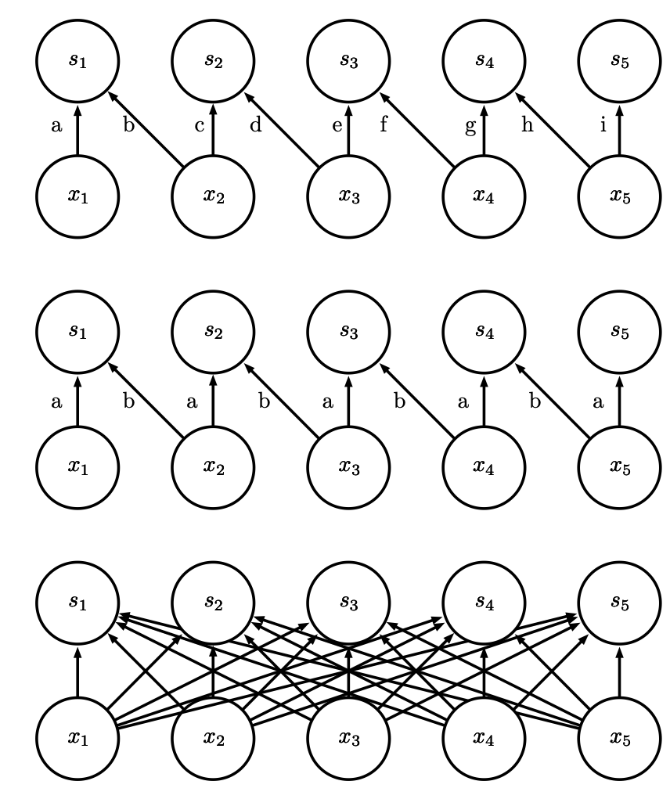
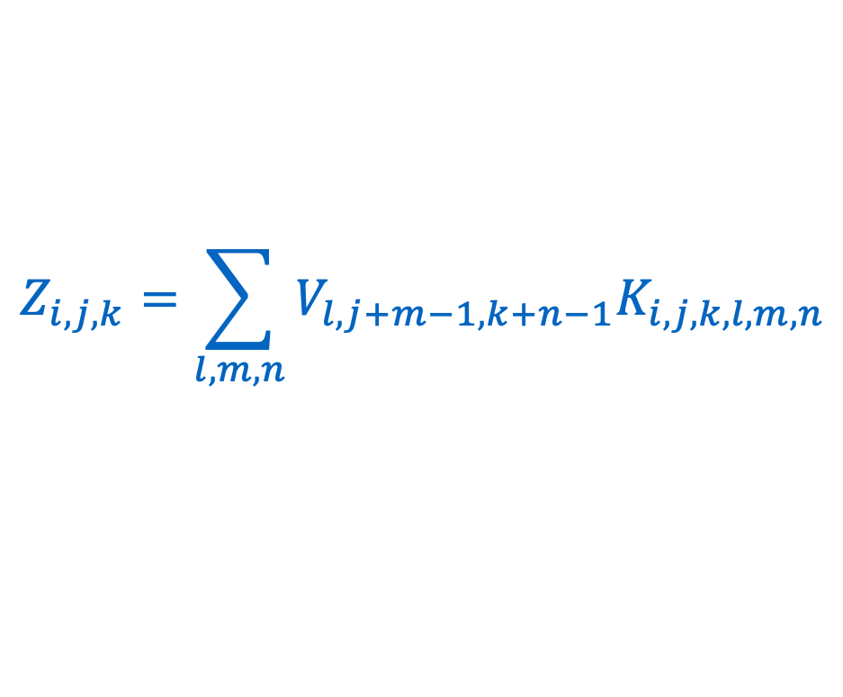
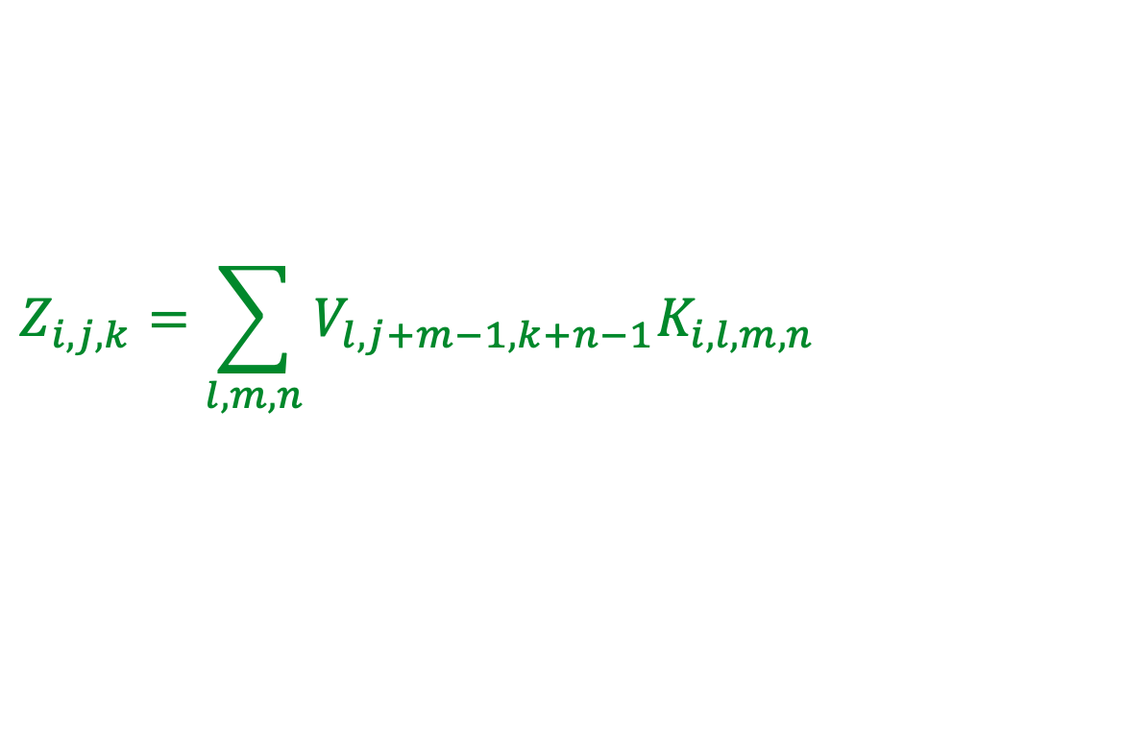
Kinds of Connectivity
Local connection:
like convolution,
but no sharing
$$Z_{i,j,k}=\sum_{l,m,n}{V_{l,j+m−1,k+n−1}K_{i,j,k,l,m,n}}$$
Convolution
$$Z_{i,j,k}=\sum_{l,m,n}{V_{l,j+m−1,k+n−1}K_{i,l,m,n}}$$
Fully connected
Figure 9.14

Slide 26
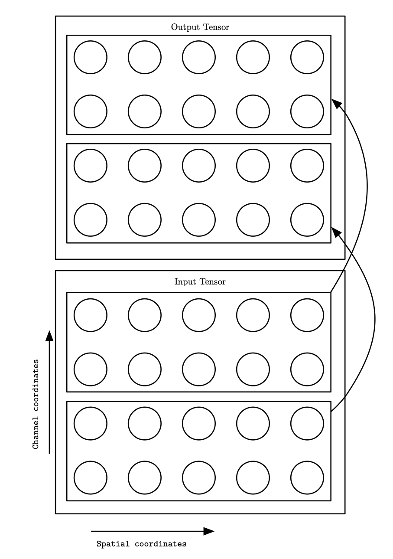
Partial Connectivity Between Channels
A convolutional network with the first two output channels connected to only the first two input channels, and the second two output channels connected to only the second two input channels.
Figure 9.15

Slide 27
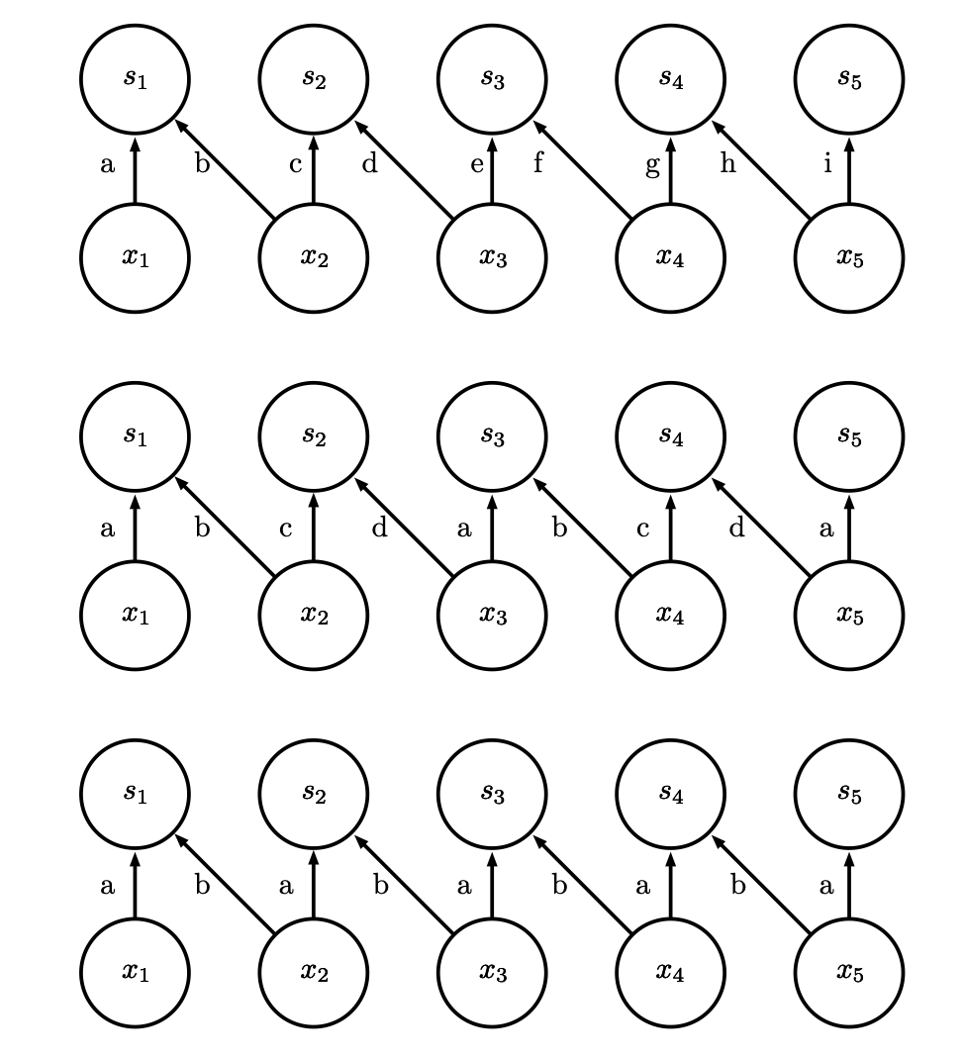
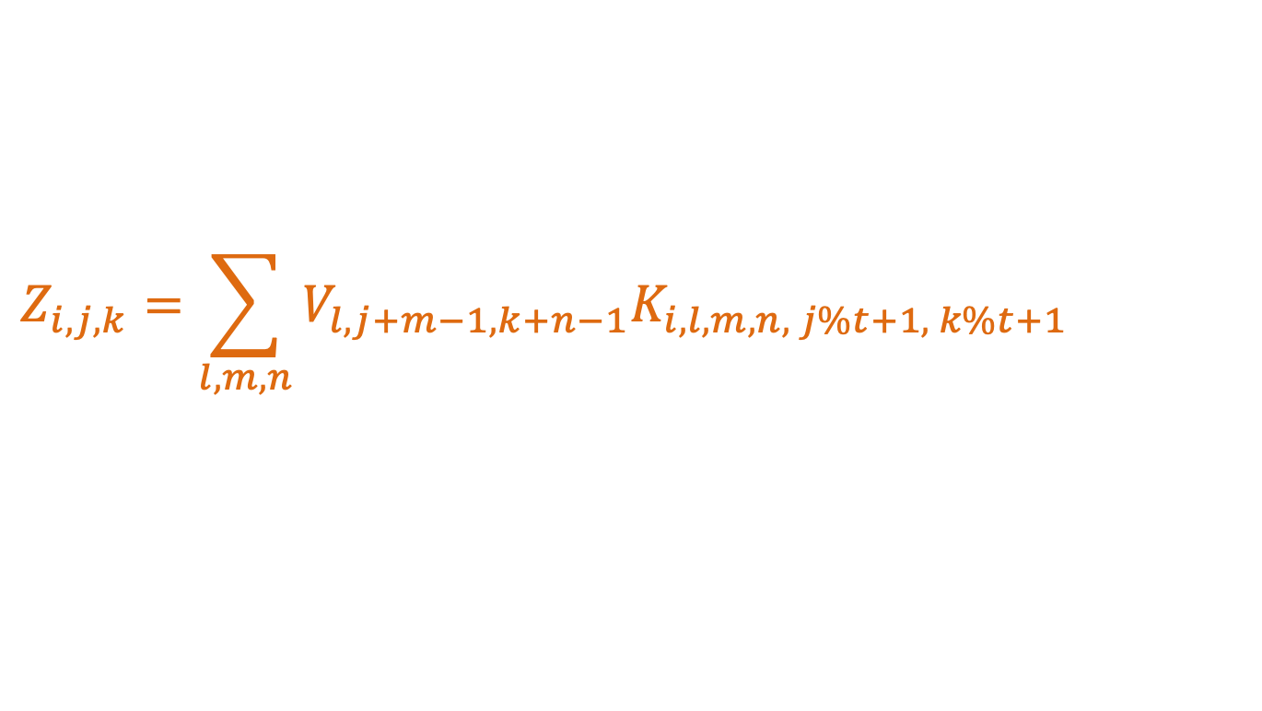
Tiled convolution
$$Z_{i,j,k}=\sum_{l,m,n}{V_{l,j+m−1,k+n−1}K_{i,l,m,n, j\%t+1, k\%t+1}}$$
Local connection
(no sharing)
Tiled convolution
(cycle between
groups of shared
parameters)
Convolution
(one group shared
everywhere)
Figure 9.16
Notes:
Both locally connected layers and tiled convolutional layers have an interesting
interaction with max-pooling: the detector units of these layers are driven by
different filters. If these filters learn to detect different transformed versions of
the same underlying features, then the max-pooled units become invariant to the
learned transformation

Slide 28
Three Operations
Convolution: (linear) like matrix multiplication
Take an input, produce an output (hidden layer)
“Deconvolution”: like multiplication by transpose of a matrix
Used to back-propagate error from output to input
Reconstruction in autoencoder
Weight gradient computation
Used to backpropagate error from output to weights
Accounts for the parameter sharing

Slide 29
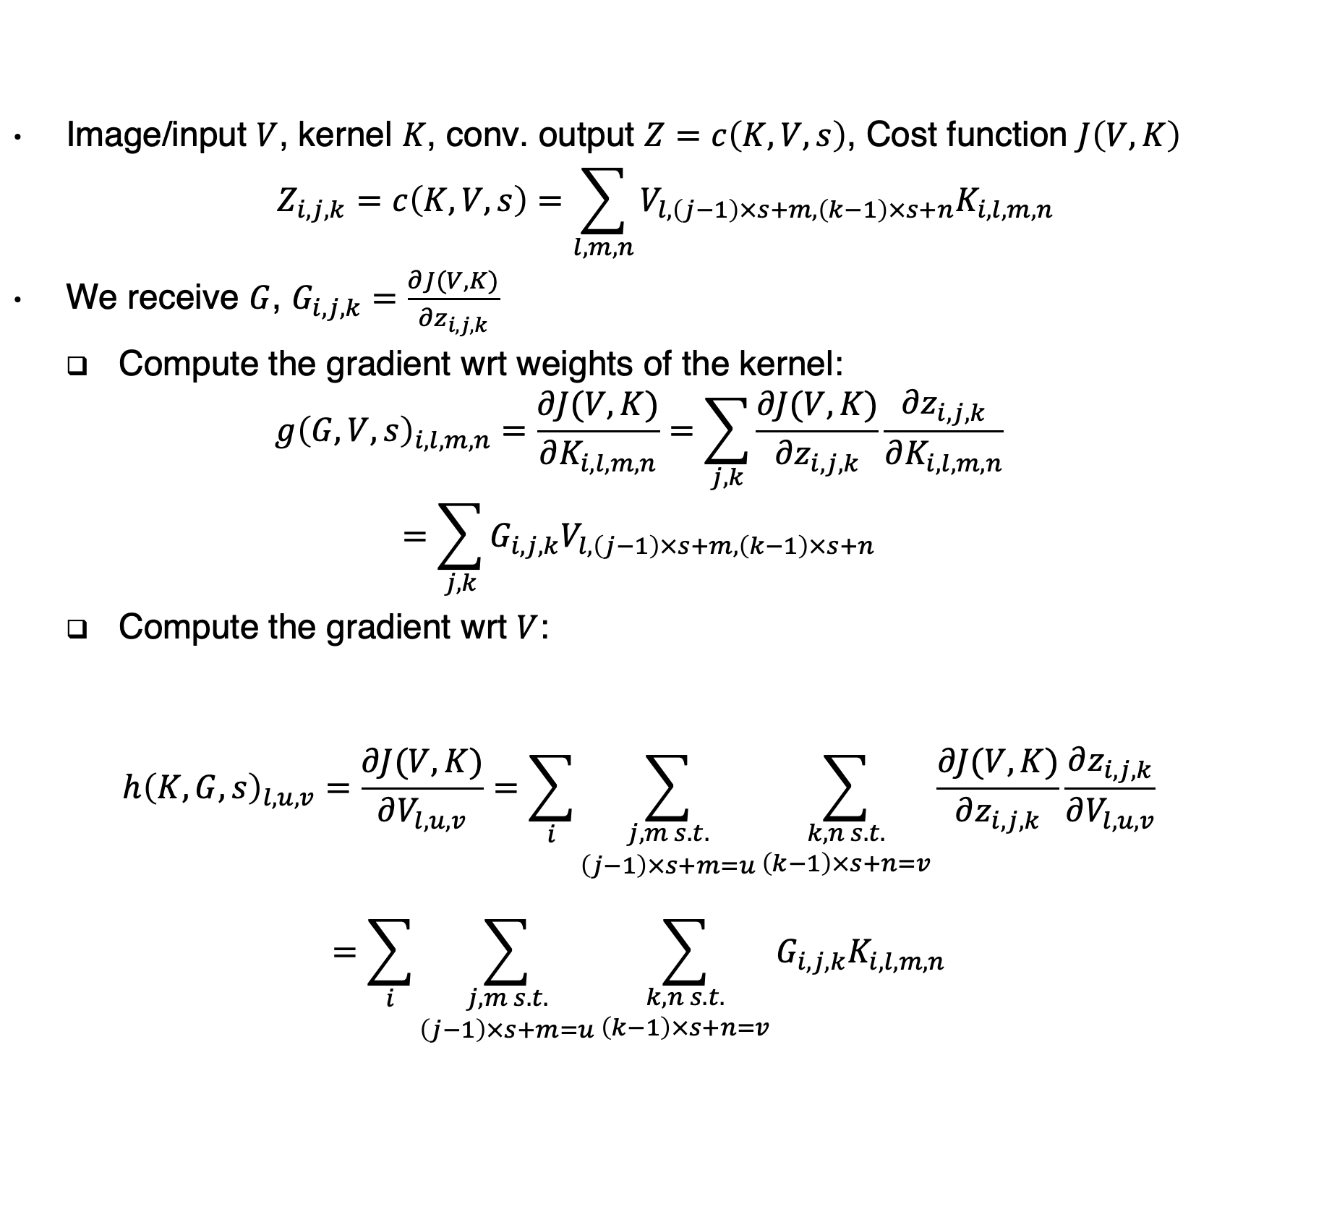
Gradient computation
Image/input $V$, kernel $K$, conv. output $Z=c\left(K,V,s\right)$, Cost function $J\left(V,K\right)$
$$Z_{i,j,k}=c\left(K,V,s\right)=\sum_{l,m,n}{V_{l,\left(j−1\right)×s+m,\left(k−1\right)×s+n}K_{i,l,m,n}}$$
We receive $G$, $G_{i,j,k}=\frac{∂J(V,K)}{∂z_{i,j,k}}$
Compute the gradient wrt weights of the kernel:
$$g{\left(G,V,s\right)}_{i,l,m,n}=\frac{∂J(V,K)}{∂K_{i,l,m,n}}=\sum_{j,k}{\frac{∂J(V,K)}{∂z_{i,j,k}}\frac{∂z_{i,j,k}}{∂K_{i,l,m,n}}}$$
$$=\sum_{j,k}{G_{i,j,k}V_{l,\left(j−1\right)×s+m,\left(k−1\right)×s+n}}$$
Compute the gradient wrt $V$:
$$h{\left(K,G,s\right)}_{l,u,v}=\frac{∂J(V,K)}{∂V_{l,u,v}}=\sum_{i}{\sum_{\begin{aligned}j,m s.t. \\ \left(j−1\right)×s+m=u\end{aligned}}{\sum_{\begin{aligned}k,n s.t. \\ \left(k−1\right)×s+n=v\end{aligned}}{\frac{∂J(V,K)}{∂z_{i,j,k}}\frac{∂z_{i,j,k}}{∂V_{l,u,v}}}}}$$
$$=\sum_{i}{\sum_{\begin{aligned}j,m s.t. \\ \left(j−1\right)×s+m=u\end{aligned}}{\sum_{\begin{aligned}k,n s.t. \\ \left(k−1\right)×s+n=v\end{aligned}}{G_{i,j,k}K_{i,l,m,n}}}}$$
Notes:
$$\left(j−1\right)s+m=u⇒m=u−\left(j−1\right)s$$

Slide 30
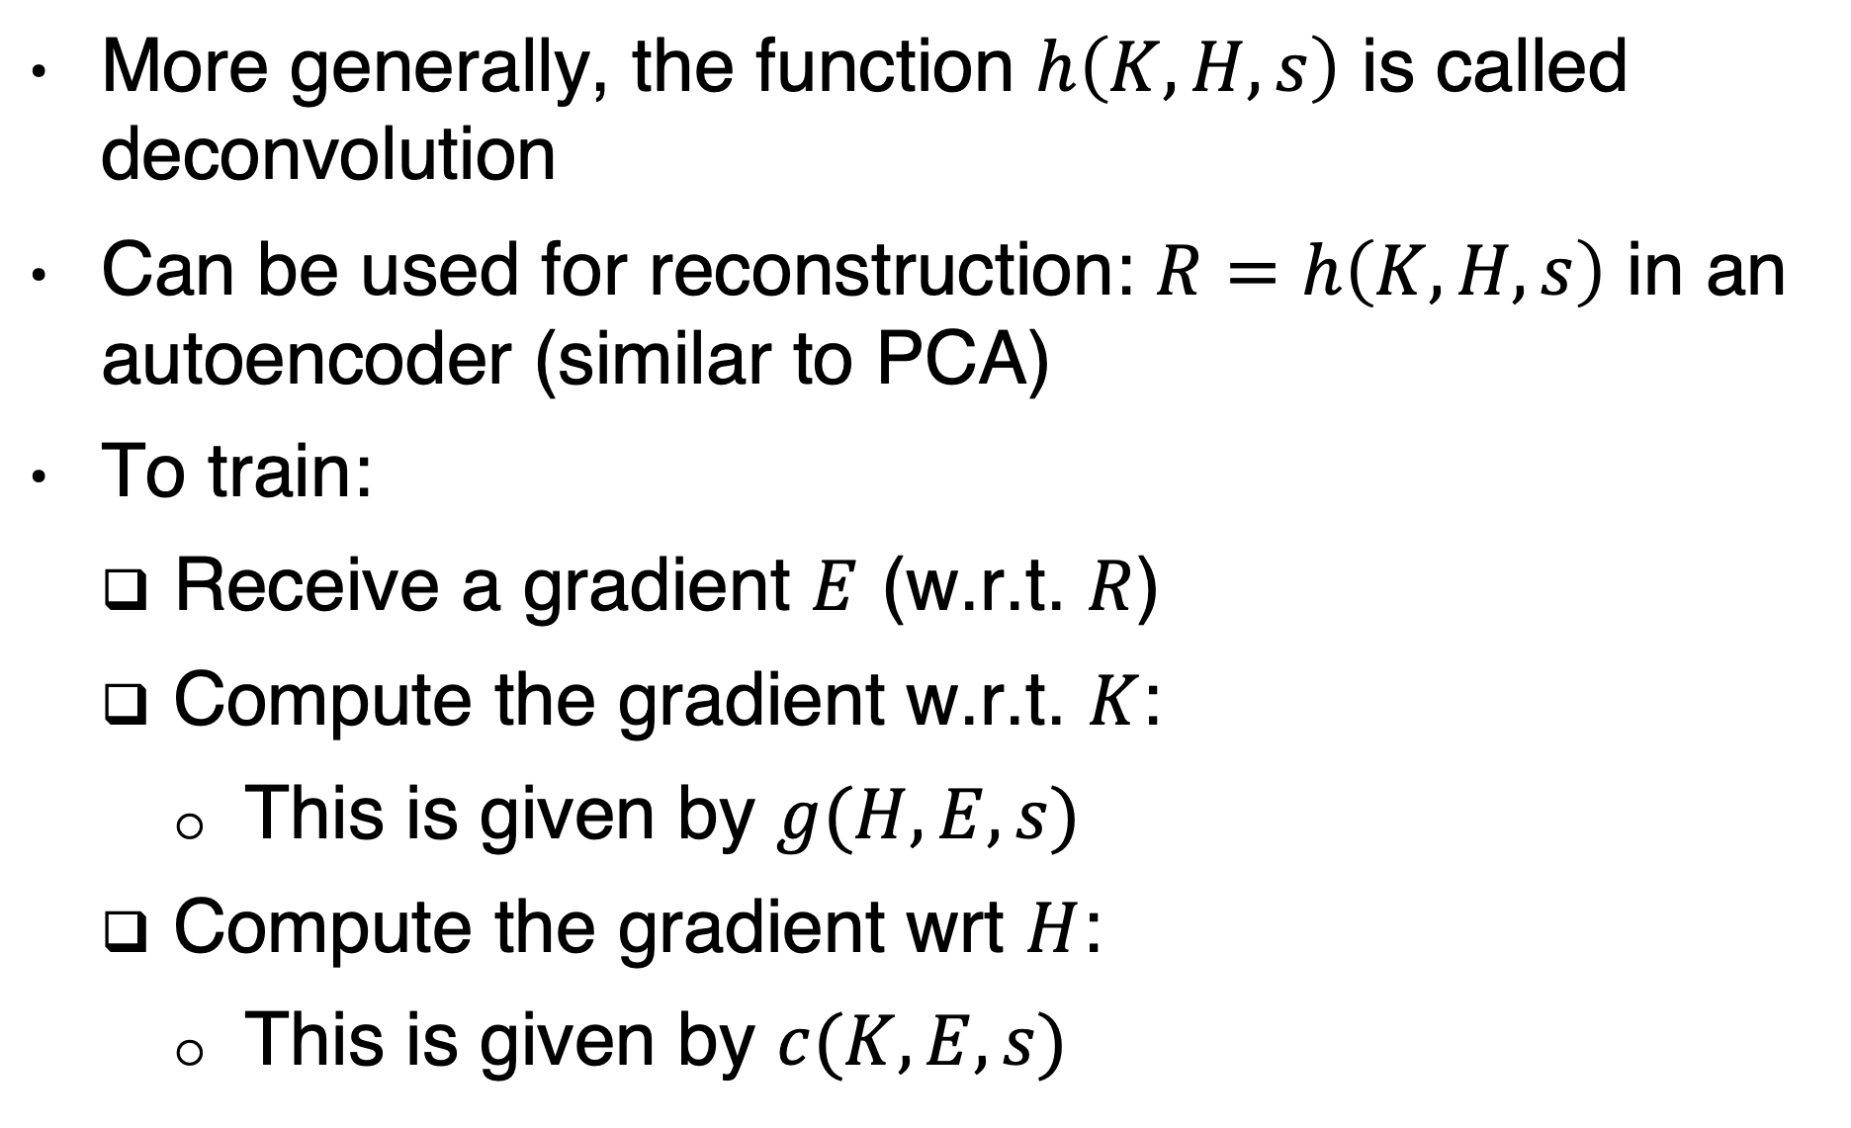
Deconvolution
More generally, the function $h\left(K,H,s\right)$ is called deconvolution
Can be used for reconstruction: $R=h\left(K,H,s\right)$ in an autoencoder (similar to PCA)
To train:
Receive a gradient $E$ (w.r.t. $R$)
Compute the gradient w.r.t. $K$:
This is given by $g(H,E,s)$
Compute the gradient wrt $H$:
This is given by $c(K,E,s)$
Notes:
Why g and c re-appear? Left as an exercise

Slide 31
Data types
 | Single channel | Multichannel
1-D | Audio waveform (amplitude over time) Channel: Amplitude Dimension: T | Skeleton animation data Each channel in the data represents the angle about one axis of one joint of a character’s skeleton. Channels: Angles Dimesion: T
2-D | Audio data that has been transformed with a Fourier transform. Rows correpsond to frequencies. (equivariance to a shift in octaves) Columns correspond to different points in time. (equivariance to shifts in time) Channel: Amplitude Dimensions: F,T | Color Image Data Channels: R,G,B Dimensions: X,Y
3-D | Volumetric data such as provening from medical imaging technology Channel: GrayScale Dimensions: X,Y,Z | Color video data Channels: R,G,B Dimesions: X,Y,T

Slide 32
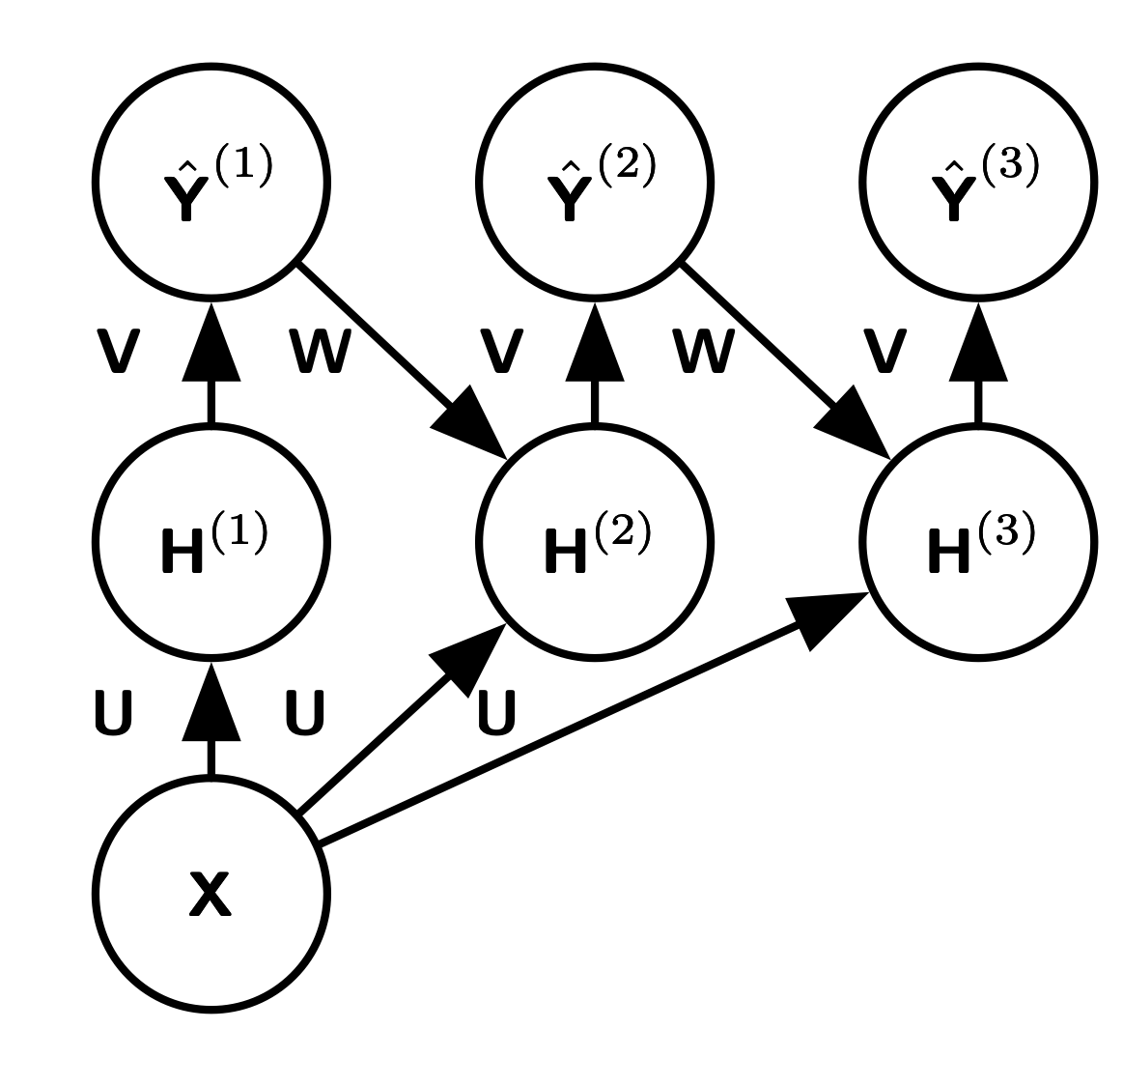
Structures output Recurrent Pixel Labeling
Figure 9.17
Notes:
An example of a recurrent convolutional network for pixel labeling. The
input is an image tensor X, with axes corresponding to image rows, image columns, and
channels (red, green, blue). The goal is to output a tensor of labels Yˆ, with a probability
distribution over labels for each pixel. This tensor has axes corresponding to image rows,
image columns, and the different classes. Rather than outputting Yˆ in a single shot, the
recurrent network iteratively refines its estimate Yˆ by using a previous estimate of Yˆ
as input for creating a new estimate. The same parameters are used for each updated
estimate, and the estimate can be refined as many times as we wish. The tensor of
convolution kernels U is used on each step to compute the hidden representation given the
input image. The kernel tensor V is used to produce an estimate of the labels given the
hidden values. On all but the first step, the kernels W are convolved over ˆ Y to provide
input to the hidden layer. On the first time step, this term is replaced by zero. Because
the same parameters are used on each step, this is an example of a recurrent network

Slide 33
Major Architectures
Spatial Transducer Net: input size scales with output size, all layers are convolutional
All Convolutional Net: no pooling layers, just use strided convolution to shrink representation size
Inception: complicated architecture designed to achieve high accuracy with low computational cost
ResNet: blocks of layers with same spatial size, with each layer’s output added to the same buffer that is repeatedly updated. Very many updates = very deep net, but without vanishing gradient.

Slide 34
Watch
https://www.youtube.com/watch?v=Xogn6veSyxA

